Slide 1


GOLD PRICES ANALYSIS 2019 TO 2024 ( CASE STUDY )
)

Slide 2
Introduction
Gold as a Safe-Haven Asset: Gold has historically been seen as a "safe-haven" investment, especially during times of economic uncertainty. It’s often used by investors to protect their wealth from inflation or market volatility.
Gold’s Role in Economic Stability: Gold prices are influenced by multiple factors such as inflation, economic stability, geopolitical tensions, and market speculation.

Slide 3
Importance of Gold Prices
Inflation: When inflation rises, the purchasing power of currencies falls. As a result, investors often turn to gold to protect their savings because gold typically retains value better than fiat currency during inflationary periods.
Economic Uncertainty: Global crises like recessions, wars, or pandemics cause stock markets to become volatile, prompting people to buy gold as a safer investment.
Interest Rates: When interest rates are low, the opportunity cost of holding non-yielding assets like gold is reduced, increasing its attractiveness.

Slide 4
Overview of Data (2019-2024)
The data presented here is based on quarterly gold prices from 2019 to 2024. By including multiple data points within each year, we can see how gold prices react to different global events.
This will allow the audience to see how volatile gold prices are over time and the effect of various economic events on its price.

Slide 5
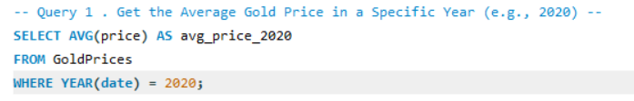
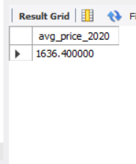
Find the Average Price for Each Year
This query calculates the average gold price for each year.
It's useful to show the overall trend for each year and how gold prices generally behaved during each period.

Slide 6
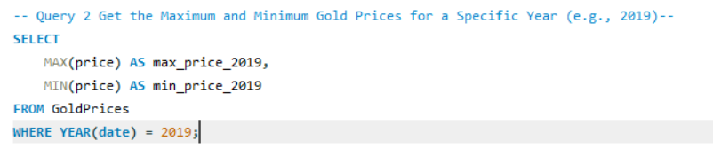
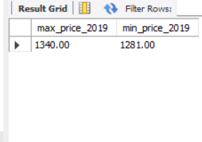
Highest and Lowest Gold Prices by Year
This query calculates the highest and lowest gold prices for each year.
MAX(price_per_ounce) gives the highest price, and MIN(price_per_ounce) gives the lowest price for each year.

Slide 7
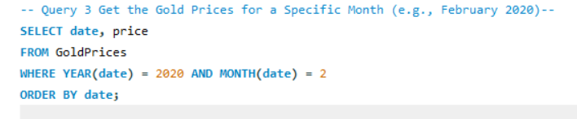
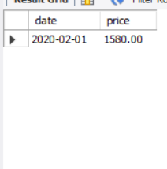
Query for a Specific Month (e.g., February 2020):
The WHERE clause filters the records for February 2020 (month 1 and year 2020).

Slide 8
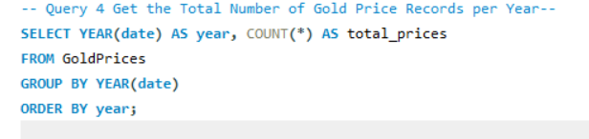
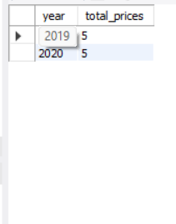
Count the Number of Entries for Each Year
This query counts how many records exist for each year.
It is useful to determine if the data is consistent (with quarterly data, there should be four entries per year).

Slide 9
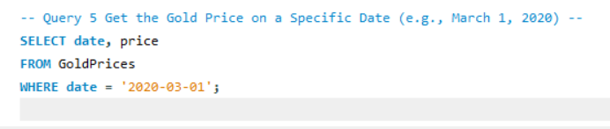
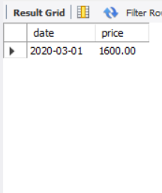
Find the Gold Price on Specific Dates (e.g., March 1, 2020)
This subquery focuses on a specific date (March 31, 2020) to show how gold prices behaved on that day. You could change the date to any other point of interest, such as the start or end of the pandemic.
This can highlight how events, like the COVID-19 lockdowns, specifically impacted gold prices.

Slide 10
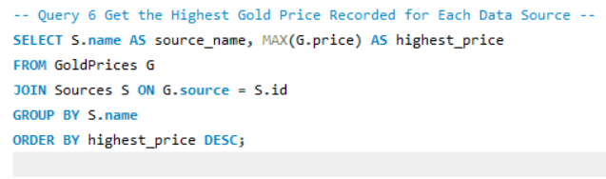
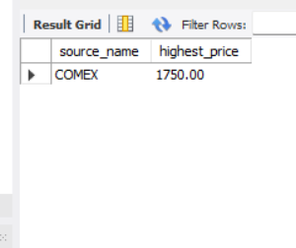
Highest Gold Prices by Data Source
This query helps identify the highest gold price recorded from each data source.
Sorting the results allows you to compare the top prices and easily identify which data source reported the highest gold price.

Slide 11
Key Takeaways
Gold is an important asset that reacts to changes in the global economy.
Major factors influencing gold prices include inflation, interest rates, economic uncertainty, and geopolitical events.
Understanding gold trends helps in forecasting future market movements and making informed investment decisions.

Slide 12
Conclusion
Gold remains one of the most reliable indicators of economic sentiment and stability.
By analyzing price trends over time, we can predict how future economic events might affect gold prices.

Slide 13

ThePhoto by PhotoAuthor is licensed under CCYYSA.

